Slide 1
NIH Updates:
Tobacco Regulatory Science Program (TRSP)
Office of Disease Prevention
Division of Program Coordination, Planning, and Strategic Initiatives
Office of the Director, NIH
Kay Wanke, Ph.D., M.P.H.
Acting Director
Tobacco Regulatory Science Program
Kay.Wanke@NIH.gov
March 5, 2026

Slide 2
Funding Disclosures
This presentation was supported by the NIH Office of Disease Prevention and the FDA Center for Tobacco Products
Please add “yes” or “no” to each table cell. If “yes”, please turn cell background color to yellow. | Tobacco Industry | E-cigarette & nicotine product industry (excluding pharma) | Pharma Industry
The work being presented has received funding or other means of support from any of the following sources: | No | No | No
Any of the authors have received funding (including consultancy) from any of the following sources in the past 5 years: | No | No | No

Slide 3
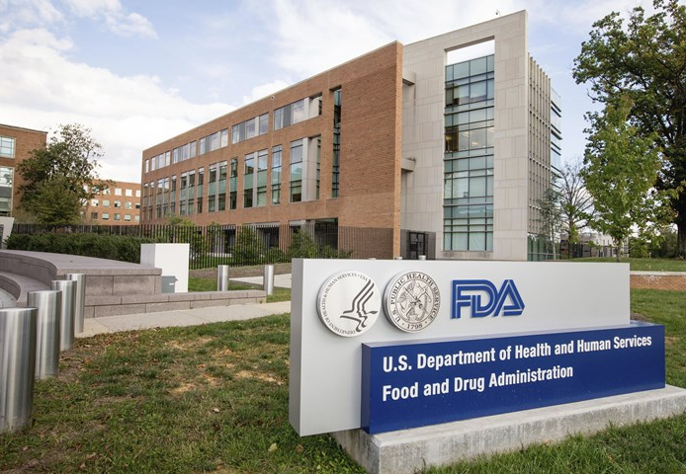
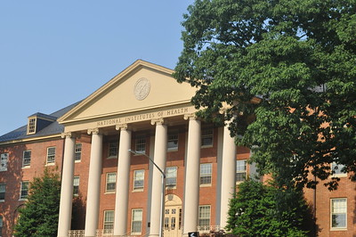








Tobacco Regulatory Science Program (TRSP)
FDA & NIH
Tobacco Regulatory Science Program

Slide 4
TRSP Portfolio
Objective: Conduct programs of multidisciplinary research to inform FDA Center for Tobacco Products (CTP) regulatory activities
Cooperative Agreement Grants (U54, U01):
    TCORS: Tobacco Centers of Regulatory Science
    CRST: Center for Rapid Surveillance of Tobacco
    P2B: Perceptions to Behavior (Tobacco Products Continuum of Risk Messaging)
    CASEL: Center for Coordination of Analysis, Science, Enhancement, and Logistics
Funding Opportunities (Clinical Trial Optional):
    RFA-OD-25-008 (R03): TRS Small Grant Program for New Investigators
    RFA-OD-26-006 (R01): Forecast – High-Priority Research in TRS
    NCATS with ODP – PAR-25-296 (UG3/UH3): Limited Competition: Clinical and Translational Science Award (CTSA) Program: Collaborative and Innovative Acceleration Award

Slide 5
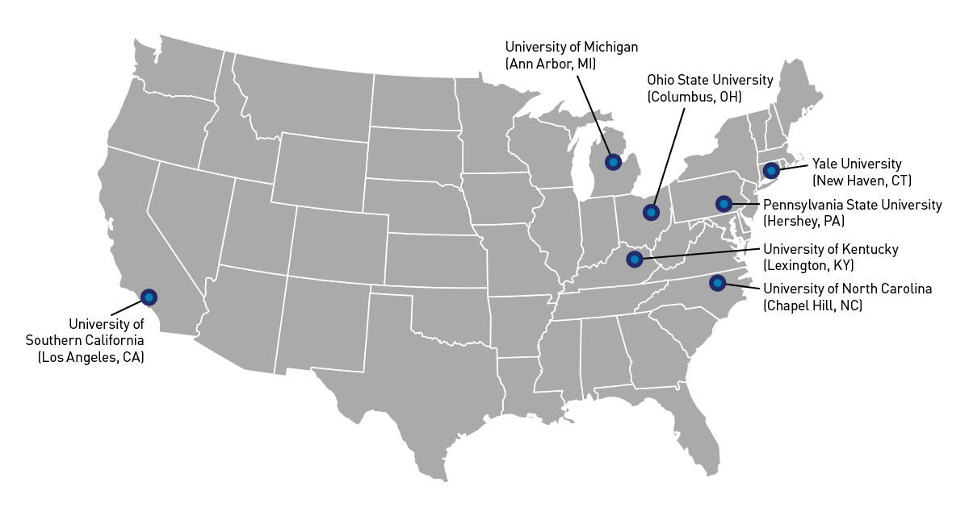

TRSP Cooperative Agreements

Slide 6

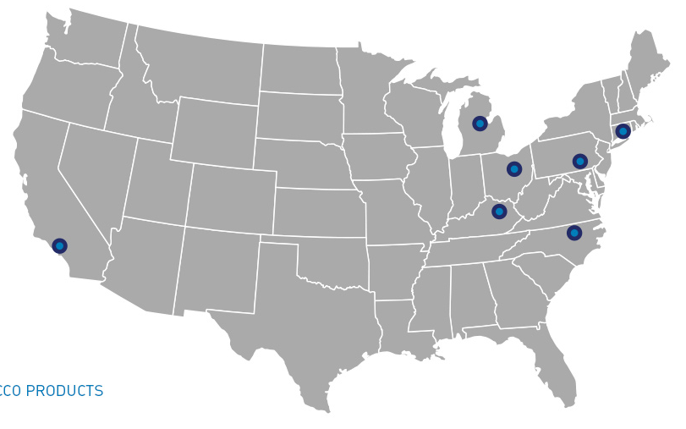

TRSP Cooperative Agreements
Rutgers
(New Brunswick, NJ)
P2B
From Perceptions
To Behavior
Johns Hopkins University
(Baltimore, MD)
Westat, Inc.
(Rockville, MD)

Slide 7
RFA-OD-25-008: Tobacco Regulatory Science Small Grant Program for New Investigators (R03)
  Eligibility:
  New and Early-Stage Investigators
  Not a previous recipient of TRSP funding
High-Priority Research Topics:
  Addiction, Behavior, Health Effects, Product Composition and Design, and/or Toxicity
Award information: $75,000 in direct costs per year and 2-year project period
Application due date: July 14, 2026
  New! Preapplication consultation: NOT-OD-26-045
  Nonresponsive applications withdrawn prior to review
  Consult with Agency Contacts (Section VII of RFA)
  FAQ document: Contact TRSP@nih.gov
  Send proposed Specific Aims for responsiveness feedback by May 14 to TRSP@nih.gov

Slide 8
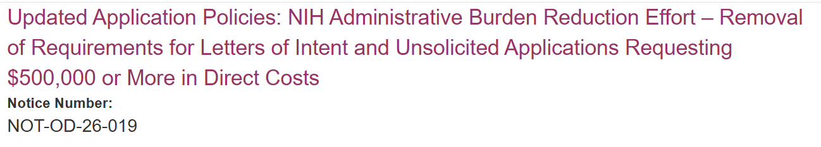
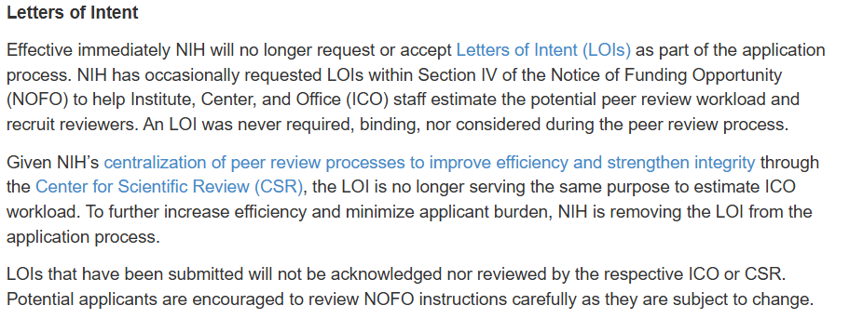
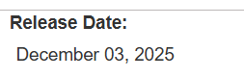
Letters of Intent No Longer Accepted (NOT-OD-26-019)

Slide 9
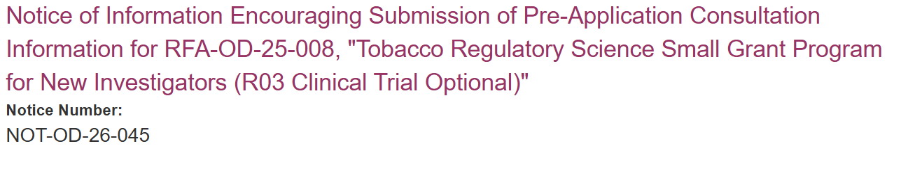
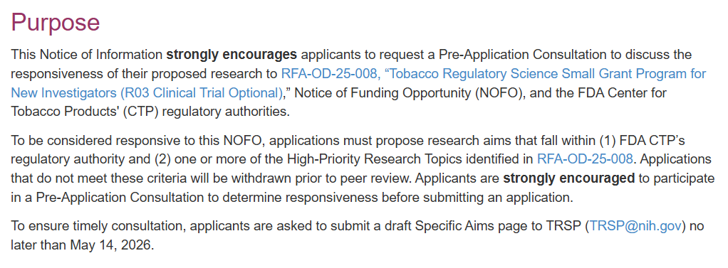
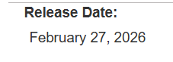

Preapplication Consultation is Strongly Encouraged
(NOT-OD-26-045)
NEW!

Slide 10
FORECAST - RFA-OD-26-006: High-Priority Research in Tobacco Regulatory Science (R01)
High-Priority Research Topics: Addiction, Behavior, Communications, Health Effects, Product Composition and Design, and/or Toxicity
Award information: $500,000 in direct costs per year and 5-year project period
Application due dates: Final dates forthcoming
Contact: Erik Rodriquez TRSP@nih.gov

Slide 11
PAR-25-296: NCATS Collaborative and Innovative Acceleration Award (UG3/UH3, Clinical Trial Optional)
Goal: accelerate translational research by supporting the collaborative development, dissemination, and sustainable implementation of innovative solutions across the CTSA Program Consortium and beyond
  Funding Mechanism: Biphasic exploratory/developmental cooperative agreement
    UG3 Phase: development, adaptation, and/or demonstration
    UH3 Phase: dissemination, implementation, and evaluation
  Limited Competition: Requires collaboration with at least 3 eligible organizations
  Award information: $650,000 in direct costs per year and 5-year project period
  Application due dates: Feb, Jun, Oct (expiration date: Oct 20, 2027)
16 days
Funded through NCATS (with ICO co-funding): Does not require FDA responsiveness

Slide 12
PAR-25-296: NCATS Collaborative and Innovative Acceleration Award (UG3/UH3, Clinical Trial Optional)
Eligibility: Limited to partnerships with 2 or more CTSA Hubs
    Clinical and Translational Science Award (CTSA) Program:
        NCATS’ national network of more than 60 medical research hubs
        DIRECTORY: https://ccos-cc.ctsa.io/resources/hub-directory
    May include RFA-listed NIH Centers: Includes TCORS, CASEL, and CRST
Project examples: diagnostics and clinical trial design, patient-reported outcomes, video repositories, clinical decision support, analytic tools, community engagement
PI at a
CTSA Hub
PI at a
CTSA Hub
PI from a CTSA
or a listed non-CTSA center
+
+

Slide 13
TRSP-Relevant Resources
NIH NOFOs, policies, etc.
  NOFOs and Forecasts now found in Grants.gov instead of the NIH Guide
  NIH Guide still publishes Notices of NIH policies, requirements, and procedural changes
  NIH Central Resource for Research Grants and Funding Information Grants.nih.gov
TRS community resources
  CASEL’s Tobacco Regulatory Science Knowledge Center https://trskcdemo.wesdemo.com/
  CRST’s fact sheets, briefings, and weekly Tobacco Industry Marking (TIM) Alerts, https://tobaccocrst.org/
  Contact us - TRSP@nih.gov -or- Kay.Wanke@nih.gov

