Slide 1
NIH Updates: NIDA
Wilson M. Compton, M.D., M.P.E.
Deputy Director
National Institute on Drug Abuse
email: wcompton@nida.nih.gov

Slide 2
Funding Disclosures
This presentation was supported by the National Institute on Drug Abuse
Please add “yes” or “no” to each table cell. If “yes”, please turn cell background color to yellow. | Tobacco Industry | E-cigarette & nicotine product industry (excluding pharma) | Pharma Industry
The work being presented has received funding or other means of support from any of the following sources: | No | No | No
Any of the authors have received funding (including consultancy) from any of the following sources in the past 5 years: | No | No | No

Slide 3
NIDA Budget Remains Stable
(All dollars are in thousands)
 | FY 2024 Operating Budget | FY 2025 Operating Budget | FY 2026 Operating Budget
Base | $1,308,070 | $1,308,070 | $1,308,070
HEAL | $355,295 | $355,295 | $355,295
Total | $1,663,365 | $1,663,365 | $1,663,365

Slide 4
NIH Extramural Research Policy Changes (selected)
Centralization of NIH Peer Review
Multi-year grant funding
New application and award structure for international collaborations NOT-OD-25-130
SBIR and STTR lapse in legislative authority NOT-OD-26-006
Authority to terminate award if a project no longer effectuates program goals or agency priorities NOT-OD-26-009
Prioritizing human based research
Supporting fairness and originality in NIH research applications NOT-OD-25-132
March 5, 2026

Slide 5
NIH Supported Tobacco Research
^ Funds for the PATH Study are obligated to NIDA via an IAA with the FDA’s Center for Tobacco Products.
Source: RCDC Categorical Spending, QVR FDA Awards Current FY Standard Report, and the NIDA Financial Management Branch
Notes:
NOTE – interpretation is that level of financial support has been essentially stable over the past decade, the year-to-year variation is only meaningful for FDA CTP-supported grants administered by NIH ICs

Slide 6

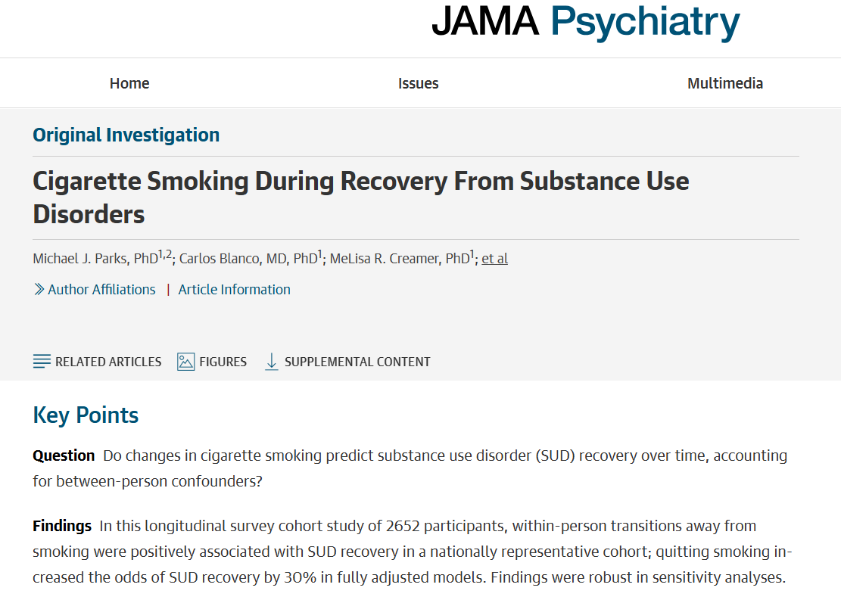
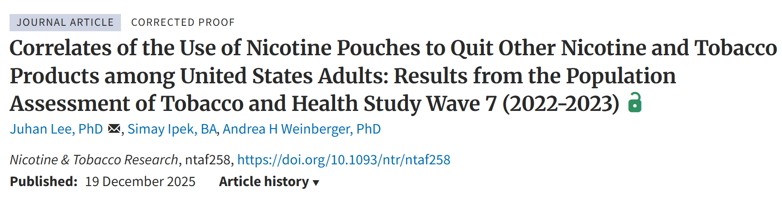
A nationally representative longitudinal study of tobacco use, its determinants, and its impacts in the U.S. noninstitutionalized population, aged 12+.
In the field continuously since 2013; collecting data in 2026 for the 14th time; over 50,000 people have participated (with multiple baselines).
The PATH Study data can be accessed at the NIDA/CTP-funded NAHDAP.
> 1000 publications from PATH (so far)
Notes:
Bottom study: Recent preliminary findings suggest males (except for Black males) with previous attempts at quitting other tobacco products were more likely to use nicotine pouches to quit ENDS and non-ENDS products (Lee et al, 2025).

Slide 7
NIDA-Supported Studies Assessing Youth Tobacco Use
The Adolescent Brain Cognitive Development Study® (ABCD)
Monitoring the Future
Past Month Use among 12th Graders
Participants were 9–10-years-old at the time of recruitment with 17-18 year-old follow up in 2025-2026.
1 in 10 pre-teen children say they’re curious about using alcohol or tobacco (Martz, et al. 2022)—Greater curiosity to use tobacco associated with being male, perceived peer cigarette use, easy availability of cigarettes, and no parental rules about cigarette use.
Tobacco use in children is associated with poorer cognitive function and smaller brain structures through a 2-year f/u (Dai, et al. 2022).
Parental, environmental, and psychosocial factors are associated with childhood tobacco (Dai et al., 2023). Parental monitoring and a positive school environment were associated with reduced susceptibility to tobacco use. Susceptibility to e-cigarette use and dual cigarette use was associated with age, female sex, and substance use history Zhang, et al., 2026).
Phone ownership and social media at ages 11-12 years old associated with greater odds of nicotine/tobacco use (Doran, et al., 2025).
Notes:
Additional study:
Higher general cognitive ability at baseline was associated with increased risk of cannabis use at 12-14 years of age. Much of this risk was mediated by positive expectancies about cannabis. Alcohol followed a similar pattern, but not tobacco use in that tobacco expectancies did not predict early tobacco use (Jones et al., 2026). However, tobacco expectancies were assessed only for cigarette smoking.

Slide 8
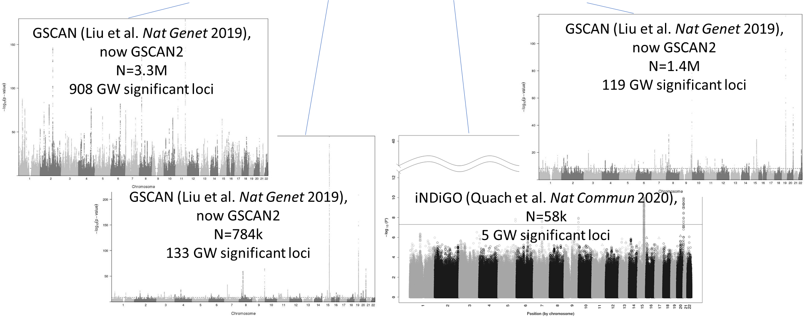
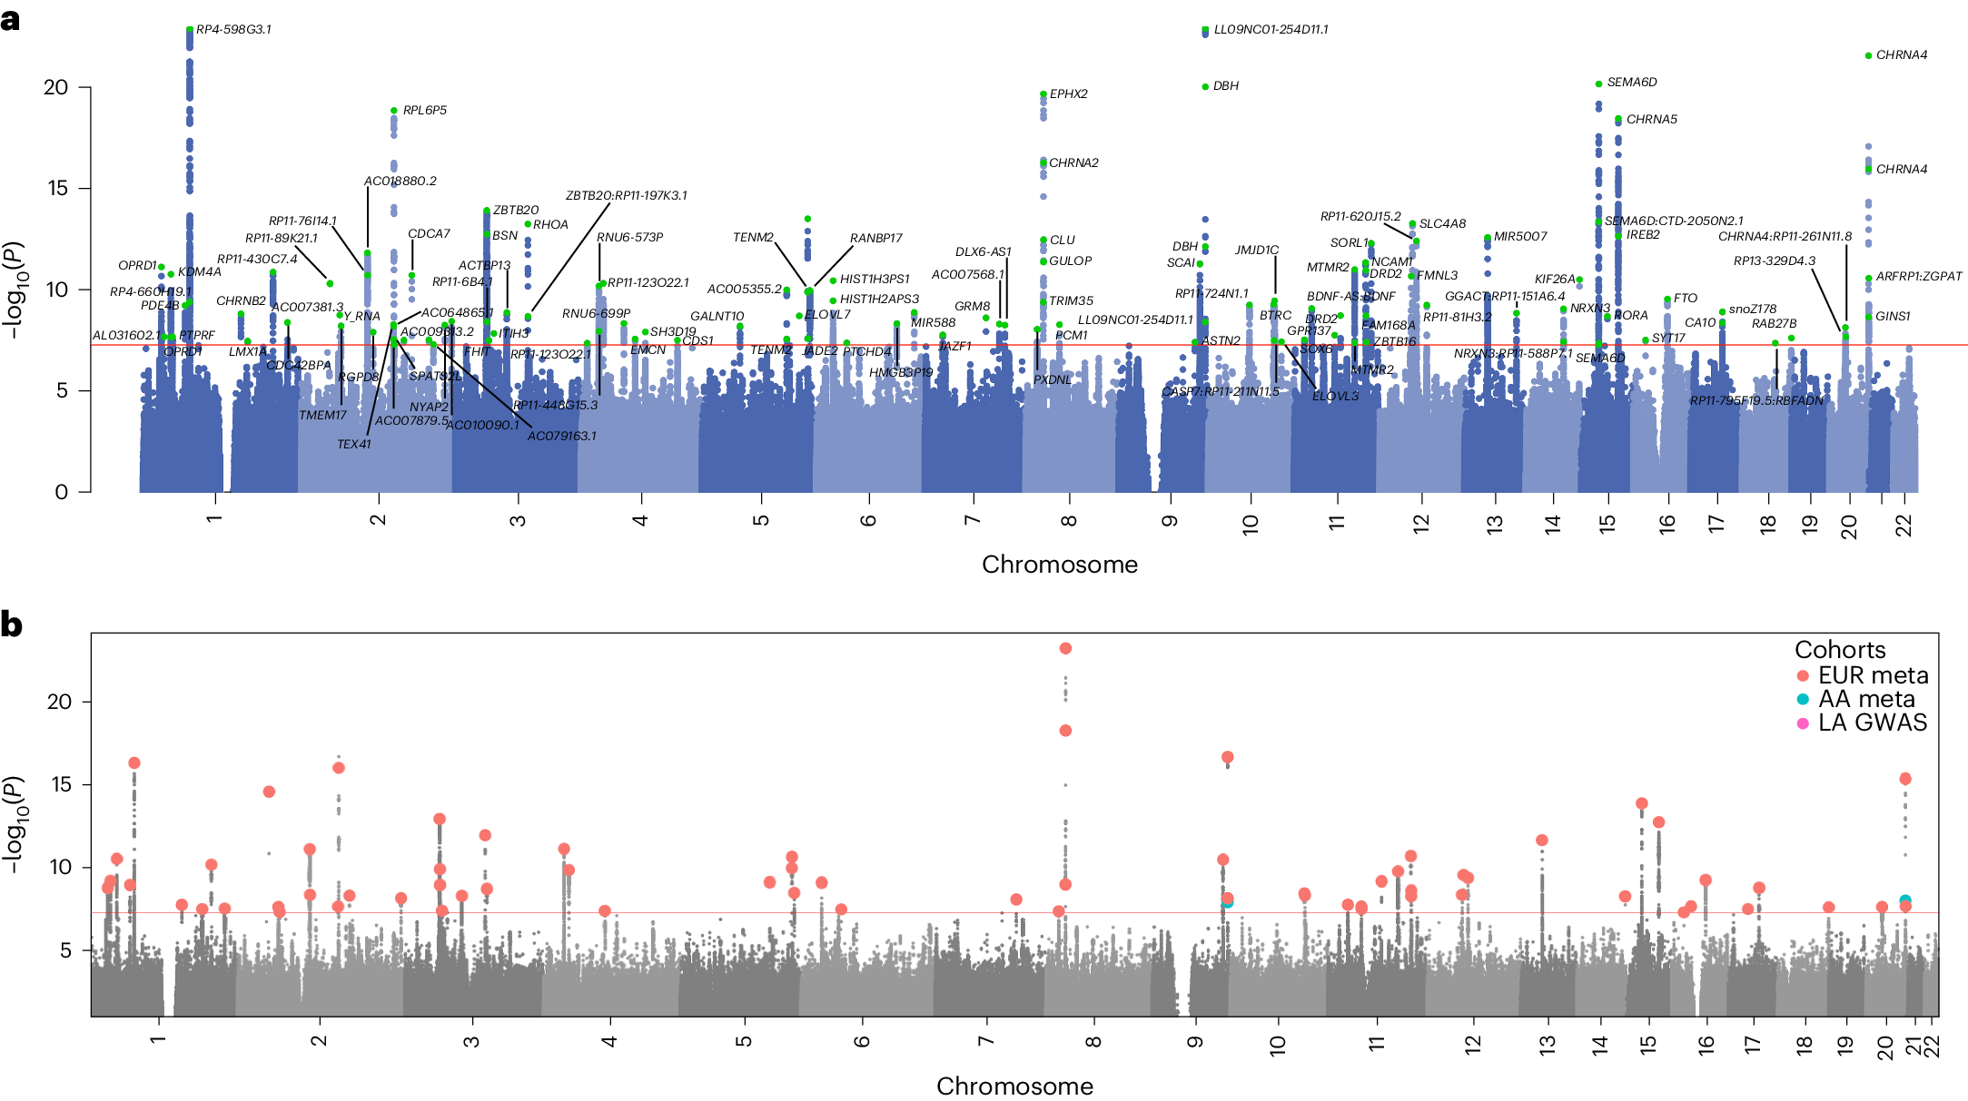
Basic Research: GWAS Along the Smoking Trajectory
Regular smoking (Cigarettes per day)
Initiation
(ever vs. never)
Dependence
Cessation (current vs. former)
Toikumo et al., Nat Hum Beh 2024),
Multi-ancestry of TUD
N=898K, 461 Risk loci
Notes:
Note the polygeneticity. Different phenotype are associated with different genes
RInitiation: h²_{snp}= 0.078 CADM2, UGP2, EHBP1, VPS54, WDPCP, DBIL5P2, OTX1, CUL3, EPHX2, CHRNA2, PTK2B, MaD1L1, NOP14, ADD1, MSFD10, C4orf10, GRK4, hTT, C4orf44, MAML3, MC4R
Regular smoking: h²_{snp}= 0.086 CHRNB3-CHRNA6, DBH, CHRNA5-CHRNA3-CHRNB4, DNMT3B, NOL4L, CHRNA4
Smoking Cessation: h²_{snp}= 0.046 CYP2A6, ACSL6, SLC22A4, C5orf56, RAPGEF6, SLC22A5, CSF2, IL3, PDLIM4, FNOP1, P4HA2, DBH, SARDH, KCNQ2, ARFGAP1, CHRNA4
elative risk of Addiction 4 out 5. h2=0.50
2024 paper link https://www.nature.com/articles/s41562-024-01851-6#Sec17

Slide 9
New Targets/Approaches in Tobacco Cessation Intervention Development (Highlights)
Novel compounds developed from drug discovery forward for tobacco cessation:
  Alpha3Beta4 partial agonist
  mrGlu2 PAM
Precision non-invasive neurostimulation targeting reward, executive control, etc., circuits with high specificity: rTMS for smoking cessation in adults with co-morbid schizophrenia and closed loop rTMS.
Repurposing of existing medications FDA-approved for non-smoking related indications, as monotherapy or as adjuvants to existing gold-standard cessation medications: GLP1s (exenatide) + NRT
Existing drugs with no FDA-approved use: Psilocybin and THCV.
Digital therapeutics and behavioral therapies, including treatments targeting adolescent vaping.

Slide 10
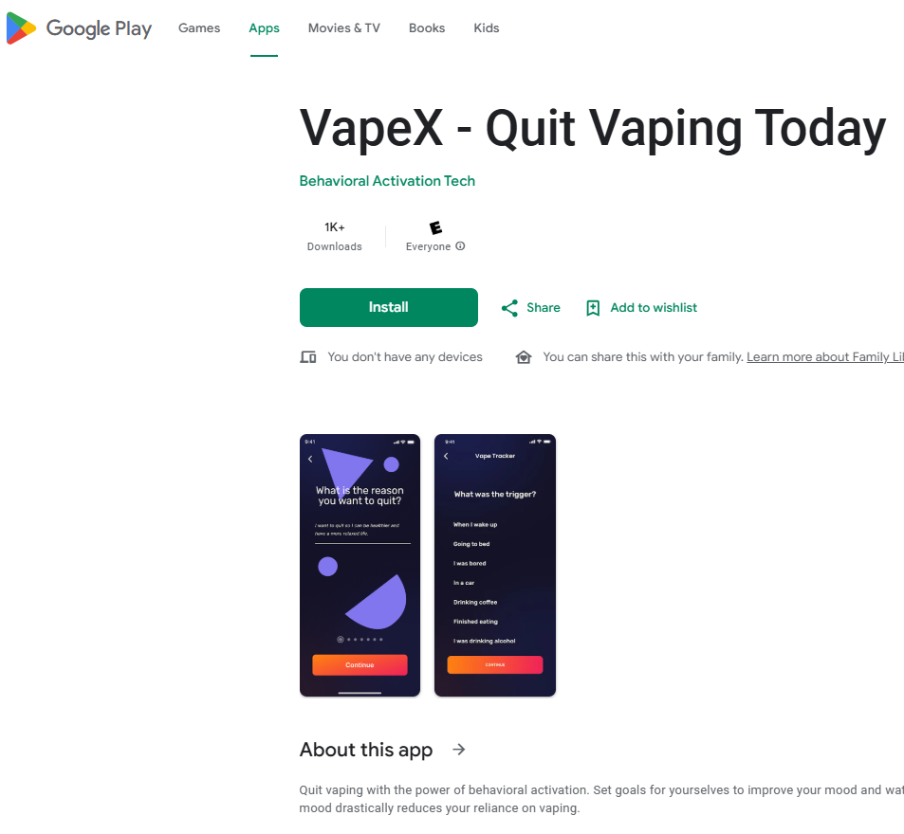
NIDA Small Business Innovation Research Program
Supports Development and Commercialization of Novel Therapies
Current research
  Assessment of a Digitally Controlled Aerosolized NRT (R42DA060773).
  Innovative E-Vape Administration of Cytisine to Enhance Patient Adherence and Treatment Completion (R43DA061725).
  Preventing SU Risk in Upper Elementary School Students (R44DA061665).
Products moving towards or already commercialized
  A Brief Behavioral Activation Mobile Application for Nicotine Vaping Cessation Among Adolescent Primary Care Patients (R41DA053856) is available as the VapeX app.
  QuitBet: A Digital Social Game that Pays You to Stop Smoking (5R44DA048668) based on contingency management is moving towards commercialization.
  Benefit and Safety of Cytisinicline (cytisine) for Cessation of Nicotine E-cigarette Use (4R44DA054784). RCT findings demonstrated efficacy of cytisinicline for 12 weeks, with behavioral support, in adults (Rigotti, et. al., 2024). The company was awarded the FDA Commissioner’s National Priority Voucher.

Slide 11
Research Areas of Opportunity (Selected)
Mitigating harms: switching rather than total abstinence
Understanding impact of other product use on smoking cessation or switching (e.g., e-cigarettes, nicotine pouches, heat not burn, synthetic nicotine)
Nicotine reduction as a strategy for decreased abuse liability
Eliminating menthol from tobacco products
Marijuana co-use via combustibles and vaping
New products/ingredients
Big Tobacco “targeted” populations and health disparities
Definitions and self-classification as a “Smoker”
Notes:
Understanding long-term health effects of use of e-cigarettes and other novel tobacco products

